Slide 1
Setting the scene & going forward….
Jill Croskell –Locality Manager
28th March 2024
Notes:
Brief Introduction and reference all subject matter links are at the end of the presentation and my email details if you need any more information.

Slide 2

Recruitment
Cornwall Overview
Demographics
Notes:
Let's have a look at where we are in Cornwall – setting the scene- this PowerPoint is in 2 parts; the second part is about what will be coming your way – what do you need to know?
This data is from the Adult Social Care Workforce Data set, I am picking out certain relevant data, but you will receive the PowerPoint to have a closer look if you want!

Slide 3
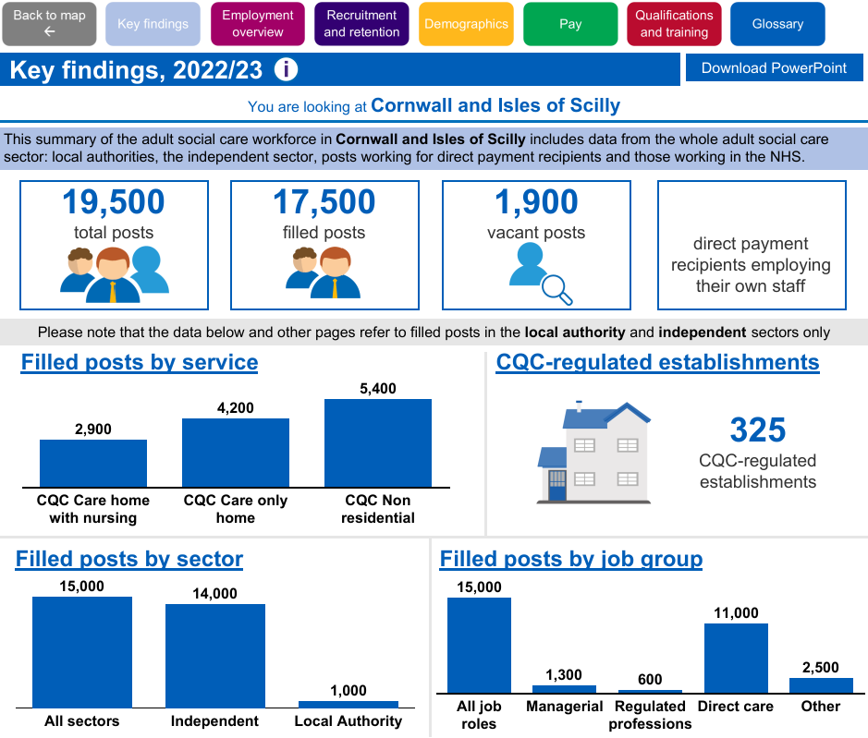
Notes:
Here is an of Cornwall’s key data findings, we will have a quick whizz through this , you will receive the PowerPoint which also has all the links , I am going to have conversation about for a deeper dive, to use with your teams ect.. on our website.
Changes:
Posts up from 18,000 to 19,500 – scale of workforce and social and economic impacts
17,500 filled posts and 1,900 vacancies.
325 CQC registered 215 residential and 110 non-residential services

Slide 4
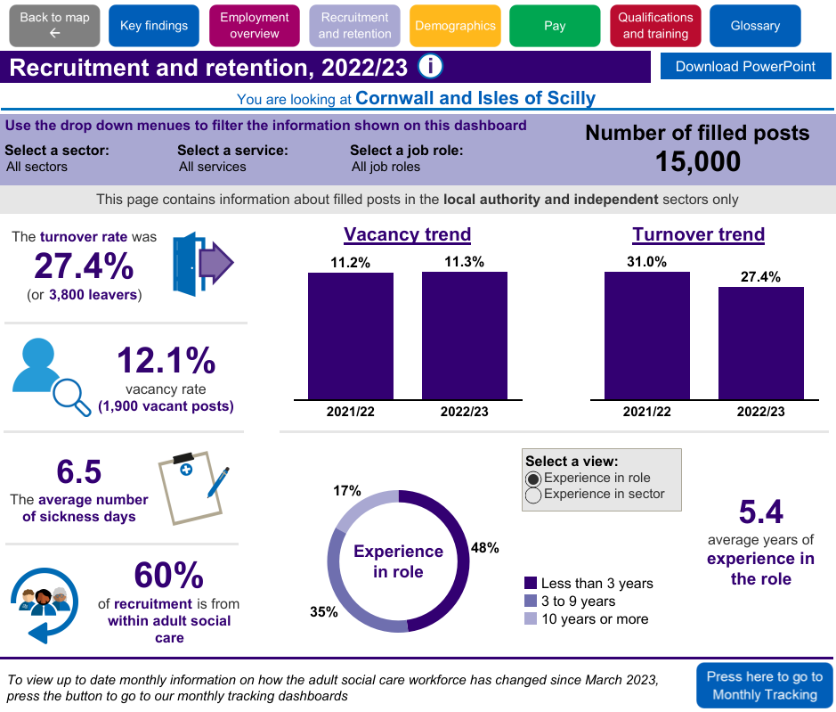
Notes:
Turnover rate of 27.4% – lower than the SW region of 32.2% but like the whole of England at 28.3%
60% of starters come from within the care sector, so a lot of retaining in the sector, but impacts for individual organisations.
5.4 is the average amount of care work experience within Cornwall, although current figures indicate this has increased.
The vacancy rate has decreased 11.30% is this due to International Recruitment ..

Slide 5
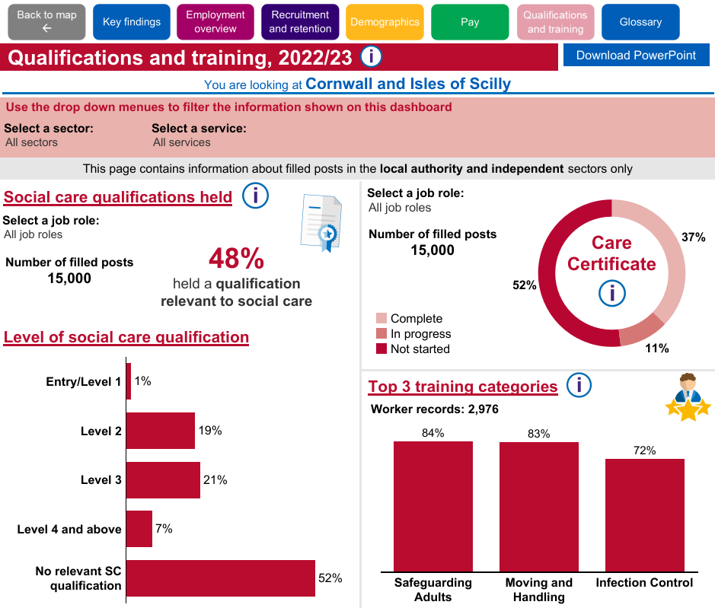
Notes:
As you can see Cornwall is doing well when it comes to some areas of learning and development for example the Care Certificate and certain training categories.
What is of concern is the 52% of staff with no SC qualification..

Slide 6
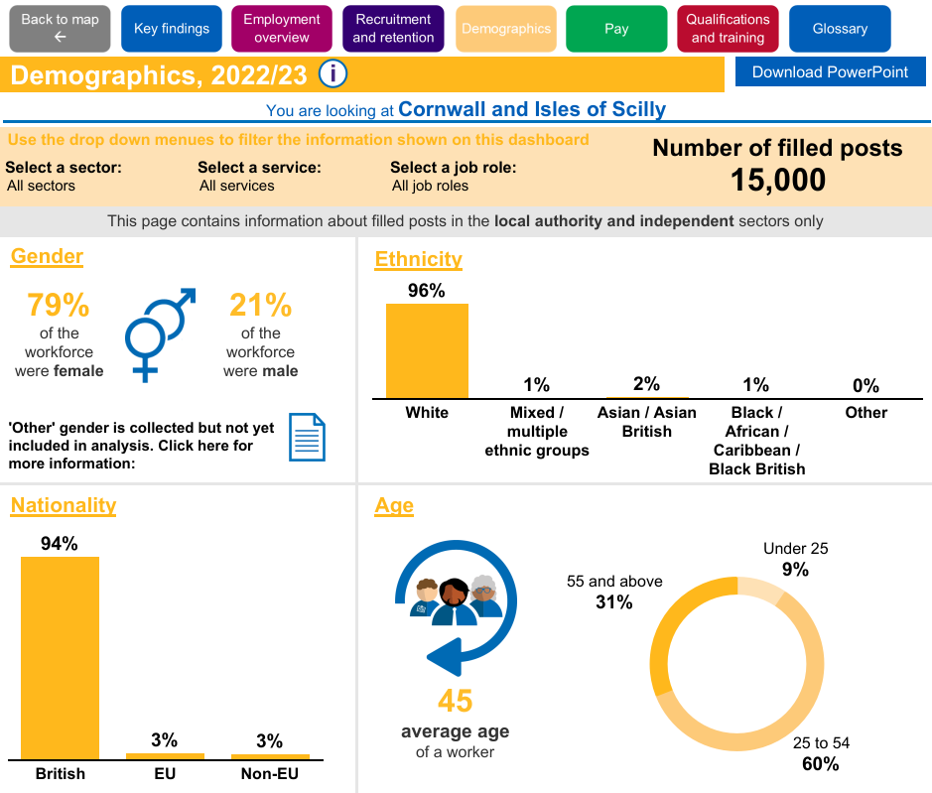
Notes:
Most of the workforce in Cornwall remains female, however, there has been a rise in male workers- is this down to IR?
Ethnicity may be changing due to IR, but diverse ethnic groups are currently small in Cornwall compared to white ethnicity and nationality, we do have growth as 3% are EU nationals and 3% are non- EU workers.
Only 9% of the workforce is under 25, and workers over 55 made up 31% of the workforce, the average age of the workforce in Cornwall is 45.

Slide 7

Notes:
Let's move onto the Have you heard part of this presentation!!
Again, this is brief, due to time constraints… but I have provided links at the end of this presentation for a deeper dive and a quick way of keeping up to date.

Slide 8
Have you Heard?
Workforce Development Fund is ending.
What is replacing this and what does it mean for me?
Notes:
The workforce Development fund is ending and, at the end of May 24 and in its place, there will be a new reimbursement scheme that will be paid directly to employers, the fund will be run by the NHS business service authority and will be hosted via a digital platform- which basically means it’s a software-based online infrastructure that facilitates user interactions and transactions. There will be a legacy fund for those undertaking longer qualifications, this will close at the end of March 25.
You will still need to be ASC-WDS compliant to make your claims for funding- I have included an information resource slide on ASC-WDS for further details within the resource section of this PowerPoint. In the interim please make sure you make you send your claims for funding for accredited courses and qualifications to Michaela at the Devon Care Collaborative who has done a grand job. Michaela’s details will be shared.

Slide 9
Changes to the Workforce Development Fund
The Department of Health and Social Care (DHSC) has agreed to extend the timescale to submit Workforce Development Fund (WDF) claims from 31 March 2024 to 31 May 2024 for all types of learning.
A legacy fund for 24/25 for all learner remaining on programmes
Full details of the current scheme and the claim form are available
Notes:
The funding deadline for 23/24 has been extended for claims to be submitted to Skills for Care by 31 May 2024. Employers can continue to claim WDF in the usual way this year (2023/24) April. We expect to have some WDF funds in 2024-25 to continue to support learning particularly to allow those that have started on large qualifications such as L3- L5 to complete and claim funding.

Slide 10

Planning a new Adult Social Care Workforce Strategy
Notes:
Last year in October, the Department of Health asked Skills for Care to develop an Adult Social Care Workforce Strategy
Skills for Care announced plans to lead the development of a new and comprehensive workforce strategy for adult social care on 12 October 2023. The strategy will identify the adult social care workforce needs over the next 15 years and set out a plan for ensuring the sector has enough of the right people with the right skills.
Why do we need a strategy?
A need for concerted and joined-up action
There are things that we can do to address the challenges in adult social care, but we need concerted and joined-up action between national and local government, Integrated Care Systems, employers and people drawing on care and support to attract and keep the right people with the right skills.
The scale and impact of adult social care
Adult social care supports people in all of our communities every day. It is a fundamental part of our community infrastructure. Our recent report ‘the state of the adult social care sector and workforce’ estimates that it also adds £55.7 billion per annum to the economy in England - which is up 8.5% from 2021/22 - and is more than the accommodation and food service activities industry.
Adult social care is not a drain on resources but a key economic driver in local communities and supports higher share economic activity in economically deprived areas. Having a strategy for such a significant workforce is essential.
Keeping the people we have
Repairing the leaky bucket - Part of this strategy is about retention, because adult social care, as we can see from the data is a ‘leaky bucket’ that we need to repair. A workforce strategy will also make sure that we are equipping people with the skills they need, and opportunities to develop and grow in their careers.
Important to say that
It will only work if it’s created by the many organisations and people that have a stake in the future of social care. To deliver a multi-lever strategy that will achieve maximum impact the development and delivery we must create collective responsibility with strong collaboration and partnership working throughout.

Slide 11






Developing an adult social care workforce strategy
The strategy will;
Identify the adult social care workforce needed over the next 15 years
Set out a plan for ensuring the sector has enough of the right people with the right skills
Help employers and commissioners with workforce planning
Support the Government’s reform agenda
Complement the NHS Long Term Workforce Plan
Notes:
These are the key priorities; this will also inform your own organisational workplans along with the Care Workforce Pathway.
All of this is linked, and this PowerPoint is designed to provide a joined-up introduction about what is coming your way and an opportunity to make preparation and hopefully make your lives easier!

Slide 12

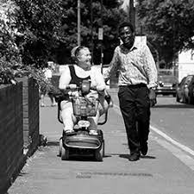
Let's look at the new Care Certificate

Slide 13
Care Certificate
Based on emerging standards with specialist themes.
A new level 2 qualification.
£53 million will fund over 37,000 learners, between June 24 and March 25.
Organisations will still need to complete the ASC-WDS to claim.
Notes:
This will be launched in June 24.

Slide 14
Next steps for the care certificate qualification
14 Awarding Organisations (AOs) are now actively developing the qualification
Continue with current standards
Launch in June 2024
FAQs
Notes:
Where are we…..The new qualification specification is now available on Skills for Care’s website
14 Awarding Organisations (AOs) are now actively developing the qualification.
AOs will also be working with training providers in preparation for delivery of the new qualification.
It is planned that the Level 2 Adult Social Care Certificate qualification will launch for the sector from June 2024. In the interim, continue with the Care Certificate standards.
FAQs are on the SfC website .
The DHSC team are now working on two key areas which include Implementation and Delivery as the next phases to support sector readiness for the new CC qual.
And if that is not enough… a new digital skills passport will be introduced by spring 2025 to improve portability of training.
We’re also developing a website for the adult social care workforce that will provide them with access to support, information and advice on careers in adult social care, linked to the pathway. This will include an explanation of the newly developed care workforce pathway, and other useful information about careers and career structures.

Slide 15

Care workforce pathway
Values
Behaviors
Responsibilities
Knowledge & Skills
Suggested learning opportunities
Specific areas of practice
Notes:
Contained within each role category is a defined set of behaviours, knowledge and skills expected of someone to work at that level.
A universal set of values for the sector, are your organisational values aligned?
The care workforce pathway also demonstrates how someone can develop within each category and Funded Learning opportunities will also be available to support each role

Slide 16
Care Career Pathway
Will cover whole workforce
First phase will focus on the care worker role
Opportunities to connect with the existing regulated workforce pathways.
Notes:
Here’s a quick overview
Will reflect and consolidate knowledge, skills and values in ASC.
Career opportunities and progression opportunities will be clear.
Consistency across England to enable quality assurance and benchmarking.

Slide 17
The Care Workforce
Pathway
New to care
Care or support worker
Supervisor or leader
Practice/ Specialist leader
D
C
B
A
Notes:
four levels of roles with each level relating to a role category so first phase of the pathway is for roles A & B move on to 2nd phase which is C&D

Slide 18
Resources

Slide 19
•

Slide 20
Get started today!
Adult Social Care- Workforce Data Set
Find out more and create your account at
www.skillsforcare.org.uk/ASCWDS
Or contact our support team for more information
T. 0113 241 0969
E. ascwds-support@skillsforcare.org.uk.
Notes:
We can’t recommend ASC-WDS enough. It will help you manage your organisation, get you access to funding and will ensure the sector has enough information to make the right decisions.
We have a dedicated support team there to help out as you get started, and you only need a few basic details about your workplace to get set up.
Head to www.skillsforcare.org.uk/ASCWDS to create your account or find out more. Remember you will still need to complete the ASC-WDS to access the new fund.

Slide 21

Your Local Workforce Development Grant Holder Contact
Michaela.cosway@devoncarehomes.org
Notes:
Here are your resource links for that deeper dive and updates.

Slide 22
Demographic Recruitment
Recruiting new demographics into social care (skillsforcare.org.uk)
Workforce Intelligence
Workforce intelligence (skillsforcare.org.uk)
Notes:
Here are your resource links for that deeper dive and updates.

Slide 23
National Workforce Strategy-
Click here for updates. https://www.skillsforcare.org.uk/search.aspx?q=workforce%20Strategy
Notes:
Here are your resource links for that deeper dive and updates.

Slide 24
Please contact me..
Jill.Croskell@skillsforcare.org.uk
Thankyou😊
Notes:
Here are your resource links for that deeper dive and updates.

