Slide 1
Care home infection prevention and control
By Alexandra Cundy, Infection prevention and control clinical nurse specialist, March 2024

Slide 2
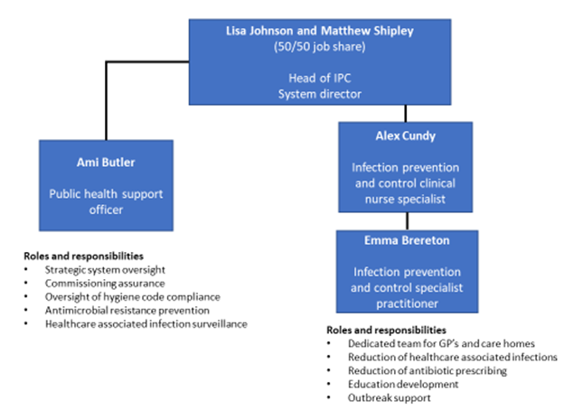
Contact details
Should you have any queries, please don’t hesitate to contact the team.
Email: ciosicb.ipc@nhs.net
Webpage with information and resources: NHS CIOS ICB IPC webpage

Slide 3
Site visits
To support with completion of a general infection prevention and control audit, and bespoke guidance on processes, and resources. A 30-minute bite size face to face training session can be added to these visits.
You said | We did
‘’We would like support with implementing hand hygiene training, audits, and competency assessment’’ | 20-minute YouTube narrated presentation on hand hygiene training and audit guidance
‘’We would like guidance on audit’’ | care home audit calendar template
‘’We would like IPC training’’’ | IPC network and care home annual updates
‘’Drop-in sessions would be beneficial’’ | Email: ciosicb.ipc@nhs.net for monthly drop-in sessions
‘’We would like guidance on mask selection’’ | Care home when do I need to wear a mask
Contact: ciosicb.ipc@nhs.net to arrange a visit to your practice.

Slide 4
Annual virtual updates (held quarterly)

Slide 5
IPC network

Slide 6
23-24 monthly newsletters
To sign up, contact the team: ciosicb.ipc@nhs.net

Slide 7

Statutory requirements
The Health and Social Care Act 2008 (Regulated Activities) Regulations 2014
Health & Safety at Work Act (1974)
Management of Health & Safety at Work Regulations (1992)
The Personal Protective Equipment at Work Regulations (1992)
Control of substances hazardous to health (COSHH) (2002)
CQC adult social care provider information
CQC KLOE for adult social care
CQC infection prevention and control inspections
To assist care home providers in evidencing CQC requirements; the IPC team have created the Care home annual report template
Infrastructure and process national guidance:
Health Building Notes (HBNs): guide design and planning of new healthcare buildings and adaptation of existing amenities
Health Technical Memoranda (HTMs): guide design, installation and operation of facilities used in healthcare delivery. Includes HTM 07-01 Safe management of healthcare waste

Slide 8
Hand hygiene training presentation and CAT
Hand hygiene training, competency assessment and audit 20 minute narrated presentation
Hand hygiene competency assessment tool

Slide 9
National standards of healthcare cleanliness (2021)
The national standards of healthcare cleanliness (2021) replaces the 2007 specifications for NHS cleanliness
National standards of healthcare cleanliness 18-minute narrated presentation
Care home cleaning specification template

Slide 10
Audits and competency assessments
care home audit calendar template
Care home annual report template
care home general audit tool (annual)
hand hygiene competency assessment tool
water safety audit tool
In our care home audit calendar template, some of the audit and competency assessment tools we recommend using are provided by Harrogate and District infection prevention and control. These are:
Aseptic technique competency assessment record for care homes
Aseptic technique procedure audit tool for care homes
Commode and commode pan audit tool
Enteral tube feeding competency audit tool
Hand hygiene audit tool for care homes
Mattress and mattress cover audit tool
Personal protective equipment audit
Pressure relieving cushion and cover audit tool
Safe management of the care environment audit tool for care homes
Safe management of care equipment audit tool for care homes

Slide 11
Further resources
NHS CIOS ICB webpage
NHS Futures NHS Cornwall IPC network workspace

Slide 12
Free resources
For further info, visit Harrogate and District NHS community IPC resources website

Slide 13
HCAI LFE

Slide 14
C. diff passport
C. diff passport
C. diff card
If you would like to order more passports, please email the team for a link: ciosicb.ipc@nhs.net

Slide 15
CFT urinary catheter policy
Urinary catheterisation in adults

Slide 16
Urinary catheter passport
To order free passports, please email ciosicb.ipc@nhs.net

Slide 17

Questions
Any questions?

